Slide 1
Predicate Logic
Rupa Mehta

Slide 2
knowledge representation in AI
Knowledge Representation Categories:
Declarative Knowledge
Procedural Knowledge
Task knowledge
Behavioural knowledge
episodic knowledge
explanatory knowledge
inferred knowledge

Slide 3
Declarative Knowledge
It is s about statements that describe a particular object and its attributes , including some behavior in relation with it
  To determine whether specific knowledge is declarative or not, an agent can ask the following question: “Can this knowledge be true or false?”
  or “Is it true or false that X?” where X is the statement in question.
  E.g. Weather Man is Mortal (True or False) : True

Slide 4
Procedural Knowledge
Gives information/ knowledge about how to achieve something
  An AI agent without prior knowledge (Declarative knowledge) of whether a declaration is true or false, to find the answer it must
    first consult with another agent, or
    explore or make observations of the environment to find out what is true or false.
  Agent as having procedural knowledge if it knows how to perform a sequence of actions in order to ensure that a declaration X will become true.

Slide 5
Procedural Knowledge (Cont..)
  To determine whether specific knowledge is procedural or not, an agent can ask the following question:
    “What actions do I need to perform in order that I can declare that X is true? ”
    If the question makes sense, then it can be deemed to be procedural knowledge.
  E.g. “What actions do I need to perform in order that I can declare that I am riding a bicycle is true”.

Slide 6
Other types of Knowledge
Task knowledge is sometimes distinguished from procedural knowledge. Task knowledge can be considered to be a specialized form of procedural knowledge where the purpose of the actions is to solve a task (e.g. find answers to a specific question).
Behavioural knowledge is knowledge that an agent has about the likely outcomes of behaviours (of itself and other agents).

Slide 7
Other types of Knowledge (cont)
Episodic knowledge :
  knowledge of “when a statement X became true”. (Time stamped set of information )
explanatory knowledge :
  can explain what caused the sequence of actions that led to the statement X becoming true.
inferred knowledge :
  can use existing knowledge to determine new knowledge that was not available by any other means.

Slide 8
Types of Knowledge (cont..)
different types of knowledge can be distinguished by the types of questions an agent can answer correctly using their knowledge:
  Declarative knowledge (can Answer) : “What is …?” and “Where is …?”
  episodic knowledge : “When did … occur?”questions
  procedural and task knowledge : “How can I/you …?”
  behavioural knowledge : “What if I/you …?”
  inferred knowledge: “If … is true, then is … true?” and “What if … were true?”

Slide 9
Knowledge categorization based on information representation
Meta Knowledge - knowledge about a knowledge and how to gain them
Heuristic Knowledge - Representing knowledge of some expert in a field or subject
  are rules of thumb or tricks.
  is used to make judgments and also to simplify solution of problems.
  is acquired through experience.
  Structural Knowledge - Describes what relationship exists between concepts/ objects

Slide 10
properties of knowledge representation system
Representational Adequacy :
  the ability to represent the required knowledge
Inferential Adequacy :
  the ability to manipulate the knowledge represented to produce new knowledge corresponding to that inferred from the original
  It must be able to derive knowledge representation structures such as symbols when new knowledge is inferred from old knowledge
  Must be able to incorporate the new information

Slide 11
properties of knowledge representation system (cont…)
Inferential Efficiency
  the ability to direct the inferential mechanisms into the most productive directions by storing appropriate guides
  It must be able to incorporate additional information into knowledge structures which may help inference process to move in promising direction
Acquisition Efficiency
  the ability to acquire new knowledge using automatic methods wherever possible rather than reliance on human intervention
  Must be able to incorporate the new information

Slide 12
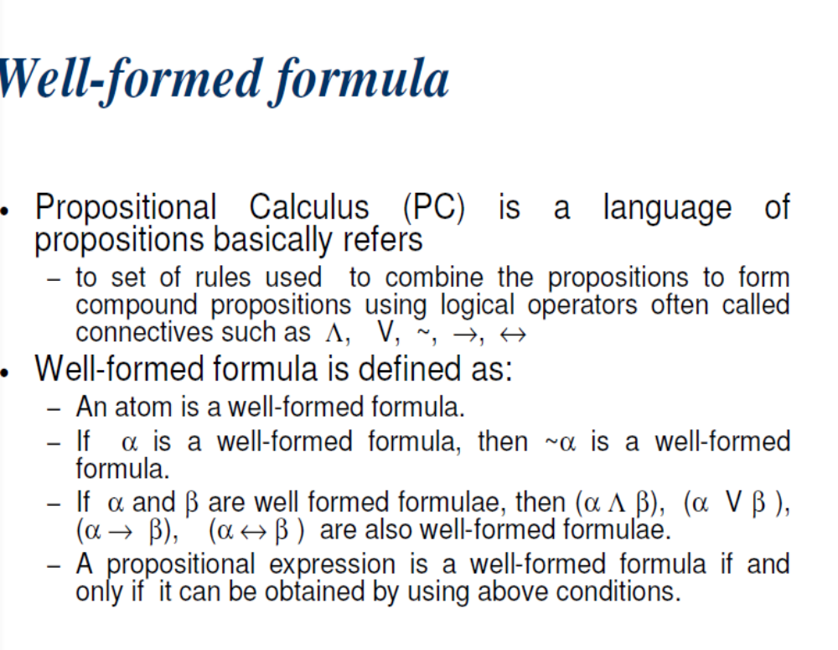
Propositional calculus

Slide 13
Propositional Logic can’t…
If X is married to Y, then Y is married to X.
If X is west of Y, and Y is west of Z, then X is west of Z.
How to Fix this issues?
  extend representation: add predicates
  Extend operator(resolution): add unification

Slide 14
Predicate Logic
Predicate logic is an extension of propositional logic that permits concisely reasoning about whole classes of entities.
E.g., “x>1”, “x+y=10”
Such statements are neither true or false when the values of the variables are not specified.

Slide 15
Predicate Logic (cont…)
It is the formal notation for writing perfectly
  Clear, Concise and unambiguous
  mathematical definitions, axioms, and theorems for any branch of mathematics
Supported by some of the more sophisticated database query engines.
Basis for automatic theorem provers and many other Artificial Intelligence systems

Slide 16
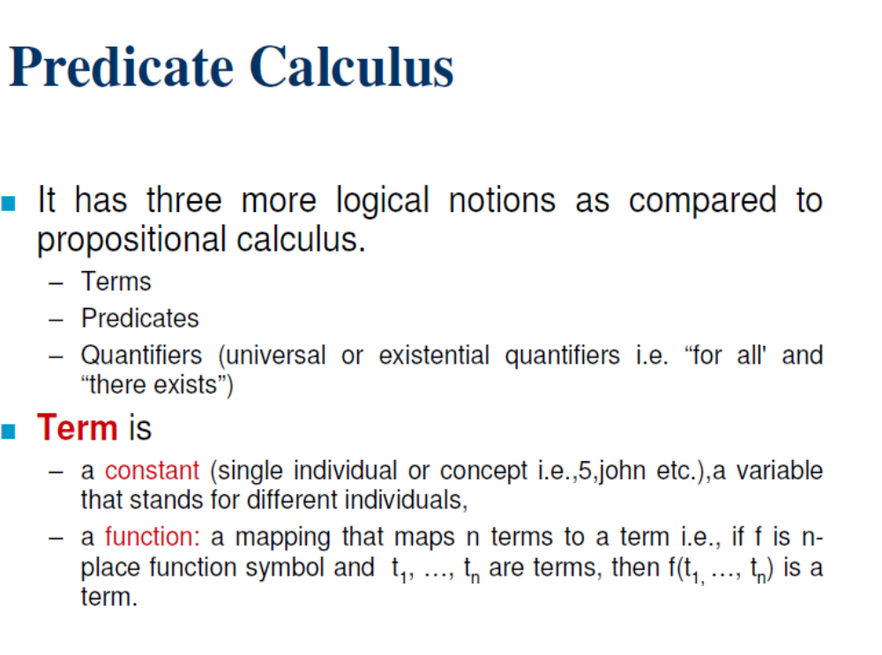
Predicate Calculus …..

Slide 17
Predicate Calculus
Syntax
Symentics

Slide 18
Syntax
Statements called Formulas
  Logical Symbols
    All connectors, (.), ∀, ∃, →, =>, <-->, variables, =
  Non Logical Symbols
    Predicates (Capital letters)
    Functions (Small letters)

Slide 19
Semantic
Validity = true in every model and every interpretation.
Interpretation = mapping of constants, predicates, functions into objects, relations, and functions.

Slide 20
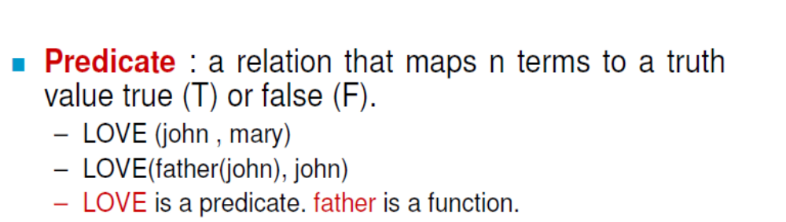
Subjects and Predicates
The proposition : “The dog is sleeping”
has two parts:
  “the dog” denotes the subject - the object or entity that the sentence is about.
  “is sleeping” denotes the predicate- a property that the subject can have.

Slide 21
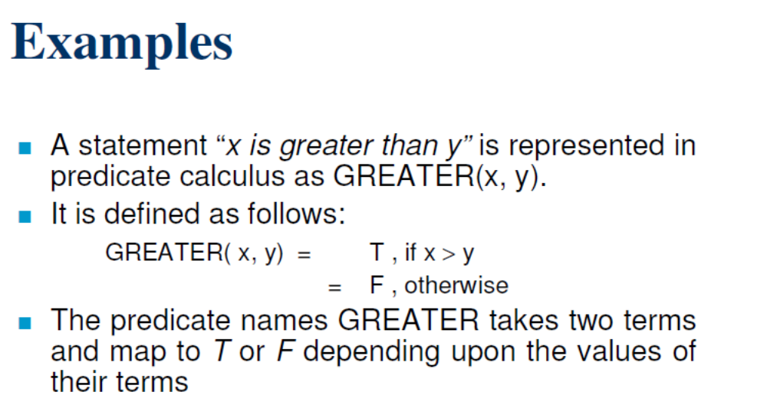
Example

Slide 22
Propositional Functions
A predicate is modeled as a function P(·) from objects to propositions.
  P(x) = “x is sleeping” (where x is any object)
The result of applying a predicate P to an object x=a is the proposition P(a).
  e.g. if P(x) = “x > 1”,
  then P(3) is the proposition “3 is greater than 1.”
Note: The predicate P itself (e.g. P=“is sleeping”) is not a proposition (not a complete sentence).

Slide 23
Propositional Functions (cont..)
Predicate logic includes propositional functions of any number of arguments.
e.g. let P(x,y,z) = “x gave y the grade z”,
x=“Mike”, y=“Mary”, z=“A”,
Propositional Function:
P(x,y,z)
= P(Mike Mary, A)
= “Mike gave Mary the grade A.”

Slide 24
Universe of Discourse
The collection of values that a variable x can take is called x’s universe of discourse.
e.g., let P(x)=“x+1>x”.
    UD is set of integers.

Slide 25
Quantifier Expressions
Quantifiers allow us to quantify (count) how many objects in the universe of discourse satisfy a given predicate:
- “∀” : FOR∀LL (universal quantifier)
∀x P(x) means for all x in the u.d., P holds.
- “∃” : ∃XISTS (existential quantifier)
∃x P(x) means there exists an x in the u.d. (that is, one or more) such that P(x) is true.

Slide 26
Universal Quantifier ∀: Example
Let P(x) be the predicate “x is full.”
Let the u.d. of x be parking spaces at UNR .
The universal quantification of P(x),
∀x P(x), is the proposition:
  “All parking spaces at UNR are full.” or
  “Every parking space at UNR is full.” or
  “For each parking space at UNR, that space is full.”

Slide 27
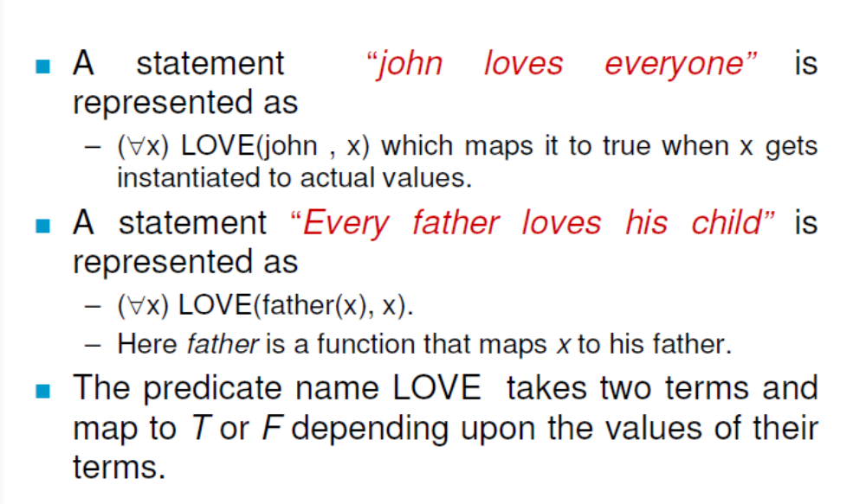
Universal Quantifier ∀: Example

Slide 28
The Universal Quantifier ∀
To prove that a statement of the form
∀x P(x) is false,
  it is sufficient to find a single counter example
  e.g. one value of x in the UD such that
  P(x) is false
  e.g., P(x) is the predicate “x>0”

Slide 29
Existential Quantifier ∃ Example
Let P(x) be the predicate “x is full.”
Let the u.d. of x be parking spaces at UNR.
The universal quantification of P(x),
∃x P(x), is the proposition:
  “Some parking space at UNR is full.” or
  “There is a parking space at UNR that is full.” or
  “At least one parking space at UNR is full.”

Slide 30
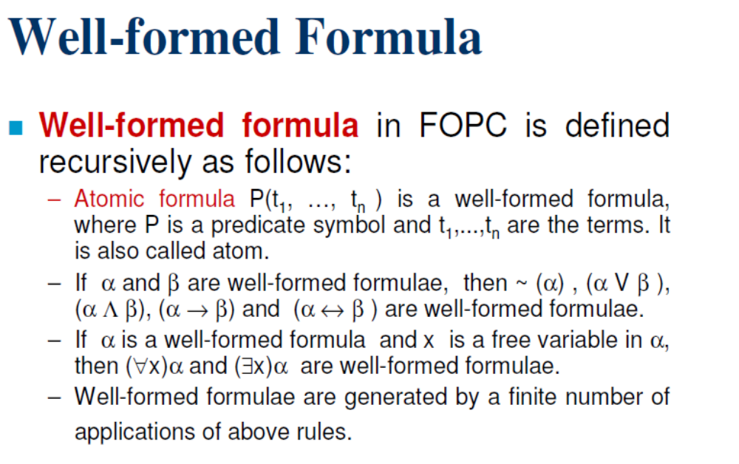
Well Formed Formula in First Order Predicate Calculus

Slide 31
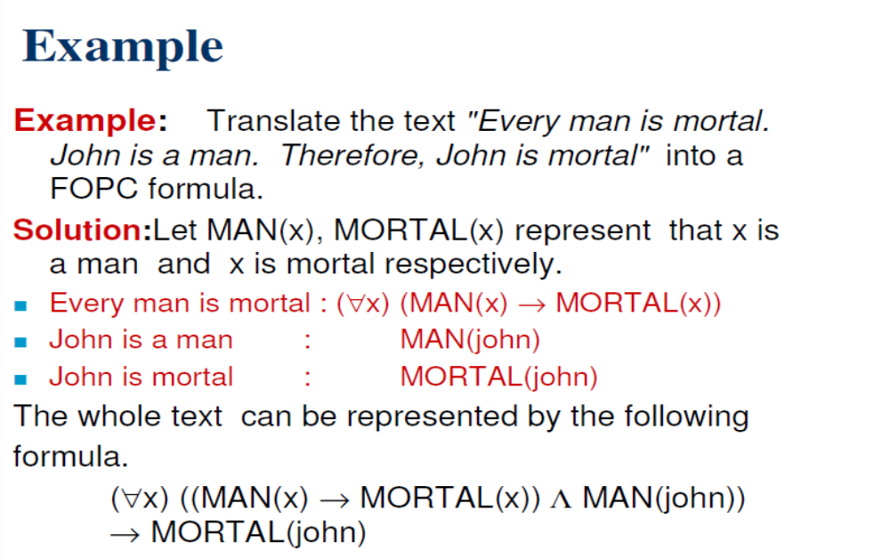
Example FOPC

Slide 32
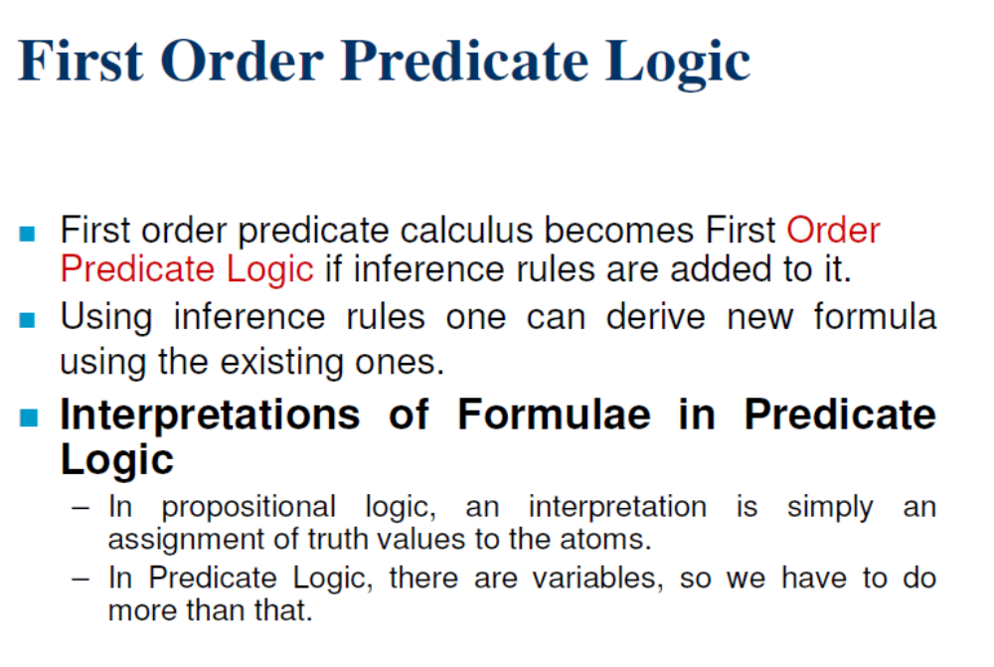
First Order Predicate Logic

Slide 33
Quantifier Equivalence Laws
Definitions of quantifiers: If u.d.=a,b,c,…
∀x P(x) ⇔ P(a) ∧ P(b) ∧ P(c) ∧ …
∃x P(x) ⇔ P(a) ∨ P(b) ∨ P(c) ∨ …
We can prove the following laws:
∀x P(x) ⇔ ¬∃x ¬P(x)
∃x P(x) ⇔ ¬∀x ¬P(x)
Which propositional equivalence laws can be used to prove this?
DeMorgan's

Slide 34
Representing World in FOL
All kings are persons.
  ∀x(King(x) => Person(x)) : OK.
  ∀x (King(x) & Person(x)) : Not OK.
    this says every object is a king and a person.
In Prolog: person(X) :- king(X).
Everyone Likes icecream.
  (∀x)Likes(x, icecream)

Slide 35
Negating Quantifiers
~ there exist x, P(x)
~ for all x, P(x)
For all x, Likes (x,Ice cream)
No one likes liver.
For all x, not Likes(x,Liver)
For all x, ~P(x)
There exists x, ~P(x)
There does not exist x, not Likes (x, Ice cream)
Not there exists x, Iikes(x,Liver).

Slide 36
More Equivalence Laws
¬∃x P(x) ⇔ ∀x ¬ P(x)
¬∀x P(x) ⇔ ∃x ¬ P(x)
∀x ∀y P(x,y) ⇔ ∀y ∀x P(x,y)
∃x ∃y P(x,y) ⇔ ∃y ∃x P(x,y)
∀x (P(x) ∧ Q(x)) ⇔ (∀x P(x)) ∧ (∀x Q(x))
∃x (P(x) ∨ Q(x)) ⇔ (∃x P(x)) ∨ (∃x Q(x))

Slide 37
Scope of Quantifiers
The part of a logical expression to which a quantifier is applied is called the scope of this quantifier.
e.g., (∀x P(x)) ∧ (∃y Q(y))
e.g., (∀x P(x)) ∧ (∃x Q(x))

Slide 38
Free and Bound Variables
An expression like P(x) is said to have a free variable x (meaning x is undefined).
A quantifier (either ∀ or ∃) operates on an expression having one or more free variables, and binds one or more of those variables, to produce an expression having one or more bound variables.

Slide 39
Examples of Binding
P(x,y) has 2 free variables, x and y.
∀x P(x,y) has
  1 free variable, Y
  and one bound variable X
“P(x), where x=3” is another way to bind x.
An expression with zero free variables is an actual proposition.
An expression with one or more free variables is still only a predicate: ∀x P(x,y)

Slide 40
More to Know About Binding
∀x ∃x P(x) - x is not a free variable in
∃x P(x), therefore the ∀x binding isn’t used.
(∀x P(x)) ∧ Q(x) - The variable x is outside of the scope of the ∀x quantifier, and is therefore free. Not a proposition.
(∀x P(x)) ∧ (∃x Q(x)) - Legal because there are 2 different x’s!
Quantifiers bind as loosely as needed:
parenthesize ∀x P(x) ∧ Q(x)
( )

Slide 41
Nested Quantifiers
Exist within the scope of other quantifiers
Let the u.d. of x & y be people.
Let P(x,y)=“x likes y” (a predicate with 2 f.v.’s)
Then ∃y P(x,y) = “There is someone whom x likes.” (a predicate with 1 free variable, x)
Then ∀x (∃y P(x,y)) = “Everyone has someone whom they like.”
(A __________ with ___ free variables.)
Proposition
0

Slide 42
Order of Quantifiers Is Important!!
If P(x,y)=“x relies upon y,” express the following in unambiguous English:
∀x(∃y P(x,y))=
∃y(∀x P(x,y))=
∃x(∀y P(x,y))=
∀y(∃x P(x,y))=
∀x(∀y P(x,y))=
Everyone has someone to rely on.
There’s a poor overworked soul whom everyone relies upon (including himself)!
There’s some needy person who relies upon everybody (including himself).
Everyone has someone who relies upon them.
Everyone relies upon everybody, (including themselves)!

Slide 43
Natural language is ambiguous!
“Everybody likes somebody.”
  For everybody, there is somebody they like,
    ∀x ∃y Likes(x,y)
  or, there is somebody (a popular person) whom everyone likes?
    ∃y ∀x Likes(x,y)
[Probably more likely.]

Slide 44
Notational Conventions
Consecutive quantifiers of the same type can be combined: ∀x ∀y ∀z P(x,y,z) ⇔
∀x,y,z P(x,y,z) or even ∀xyz P(x,y,z)
Sometimes the universe of discourse is restricted within the quantification, e.g.,
  ∀x>0 P(x) is shorthand for
  “For all x that are greater than zero, P(x).”
  ∃x>0 P(x) is shorthand for
  “There is an x greater than zero such that P(x).”

Slide 45
Some Number Theory Examples
Let u.d. = the natural numbers 0, 1, 2, …
“A number x is even, E(x), if and only if it is equal to 2 times some other number.”
∀x (E(x) ↔ (∃y x=2y))
“A number is prime, P(x), iff it isn’t the product of two non-unity numbers.”
∀x (P(x) ↔ (¬∃y,z x=yz ∧ y≠1 ∧ z≠1))

